Slide 1
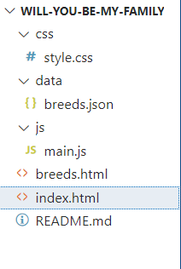
File order

Slide 2
style.css – Styling the Website
This CSS file defines the visual appearance of the adoption website. It styles the grid layout, individual pet cards, filter buttons, modal windows, and the search bar. Hover effects and transitions help improve interactivity and user experience.

Slide 3
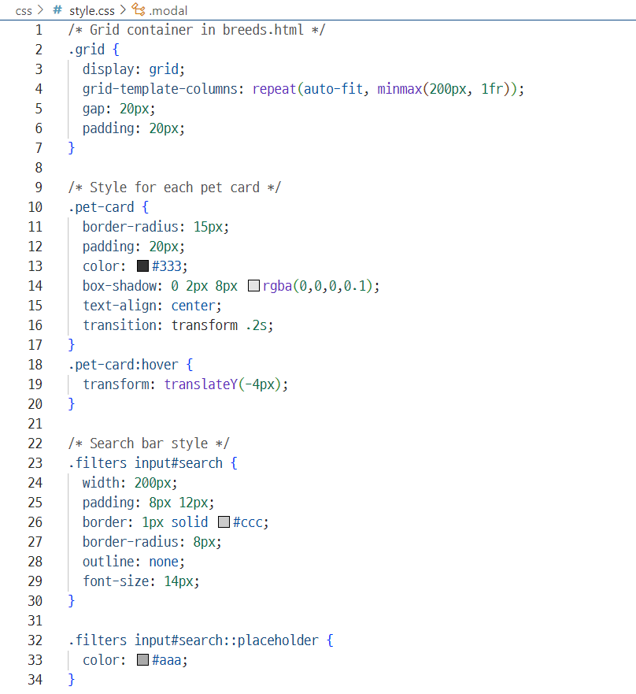
style.css – Code Snippet

Slide 4
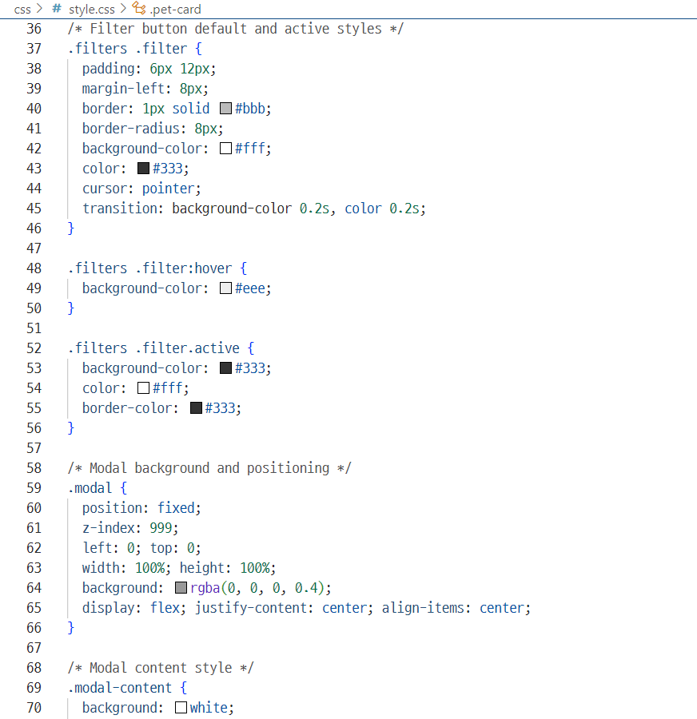
style.css – Code Snippet

Slide 5
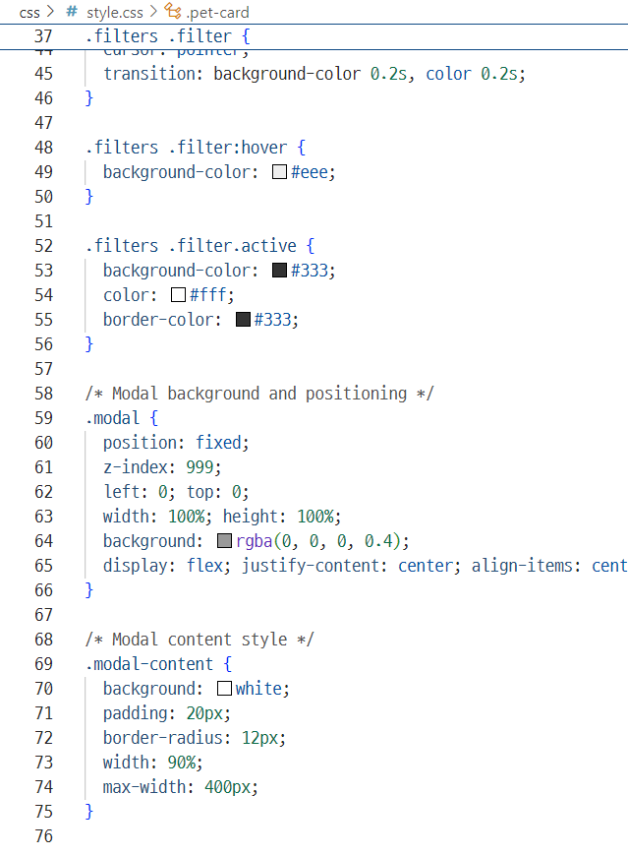
style.css – Code Snippet

Slide 6
breeds.json
breeds.json file is a structured dataset that stores information about adoptable pets. Each entry includes details such as:
name: the breed or type of the animal
type: Dog or Cat
size: Small, Medium, or Large
personality: a brief personality trait
available: adoption availability (true/false)
image: a URL to a representative image
note: special observations or health notes
description: rescue location and background
This file allows the website to dynamically display and filter pet listings using JavaScript.

Slide 7
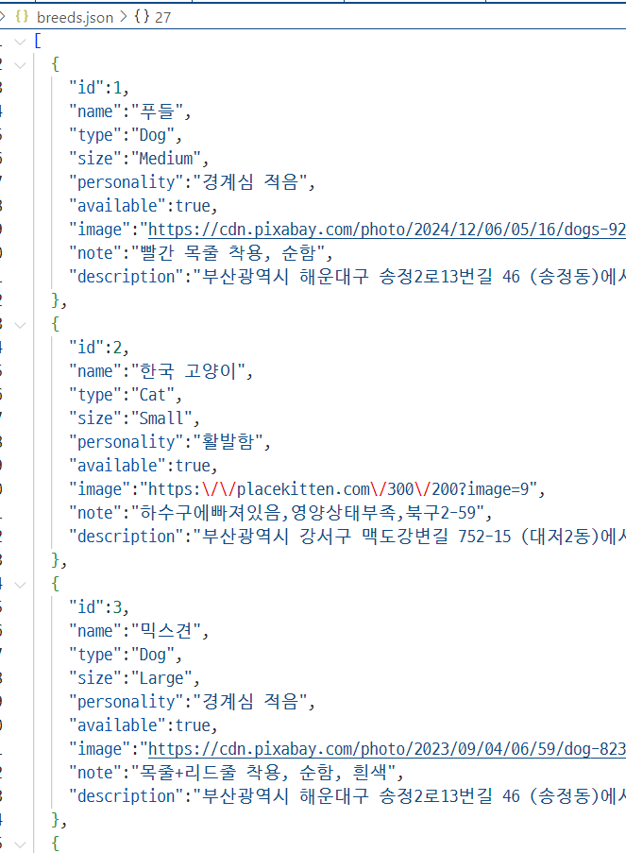
breeds.json – Code Snippet
*The data was collected from the national abandoned animal protection center,but filtered to include only animals located in Busan.

Slide 8
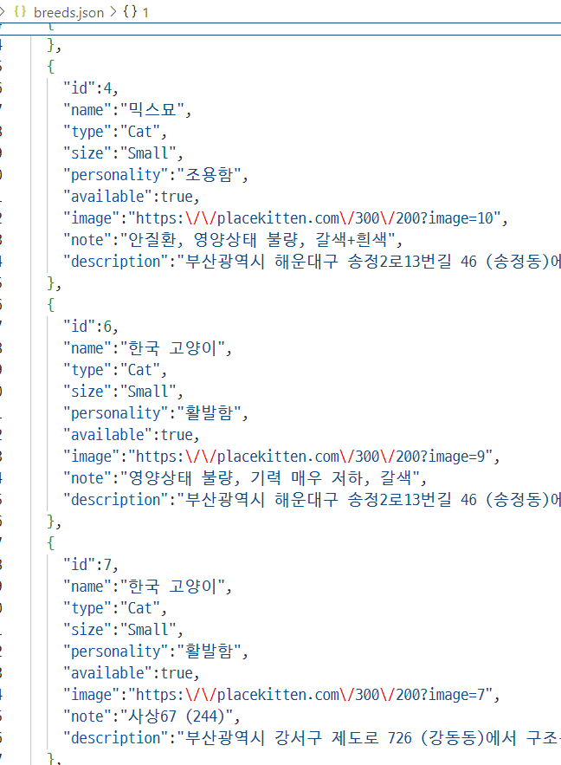
breeds.json – Code Snippet

Slide 9
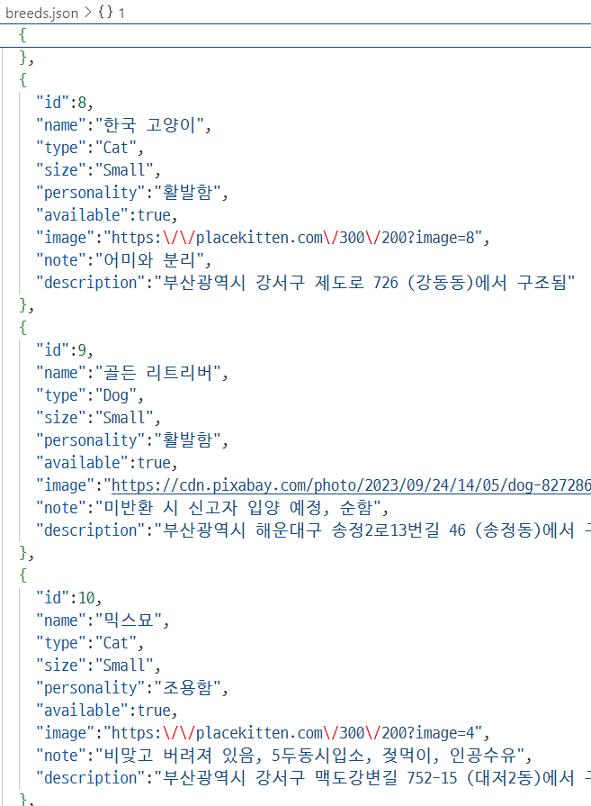
breeds.json – Code Snippet

Slide 10
main.js
main.js controls the interactivity of the website and dynamically displays pet data based on user actions.
It loads data from breeds.json using fetch() when the page is loaded.
The data is stored in a variable (allPets) and used for filtering.
Search and filter features are handled with event listeners:
typing in the search bar or clicking a filter button triggers applyFilters().
The applyFilters() function filters pets by:
type (Dog/Cat),search text (name),and availability status.
Filtered results are passed to renderCards(),which creates HTML elements dynamically and displays pet cards in the #pet-list container.
This ensures the user sees updated results immediately when interacting with the page.
.

Slide 11
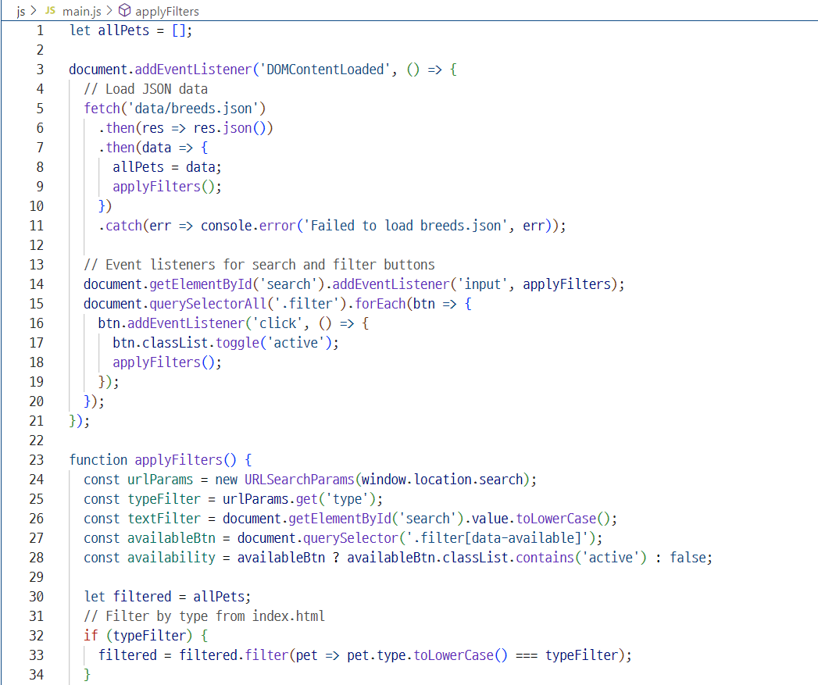
main.js– Code Snippet

Slide 12
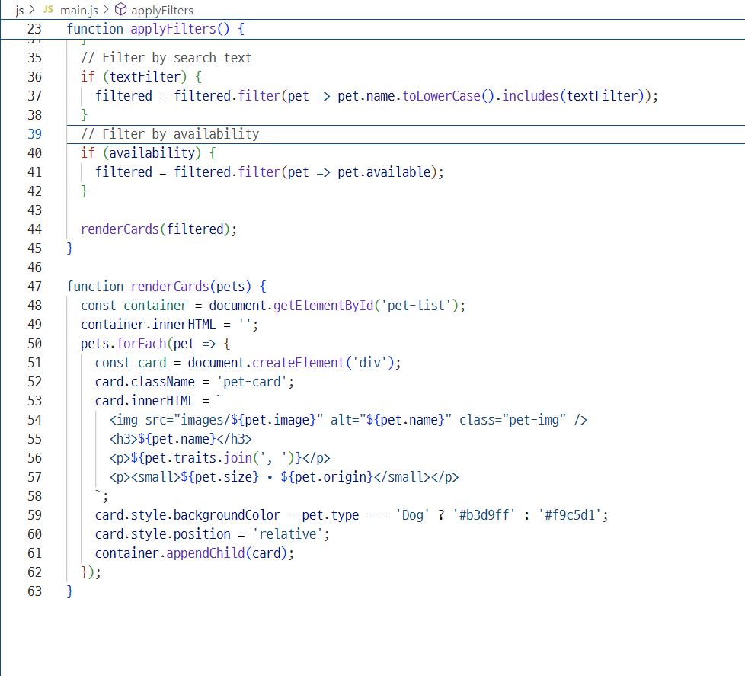
main.js– Code Snippet

Slide 13
breeds.html
breeds.html is the structure that works with CSS and JSto display and filter pet listings dynamically
<head> includes:style.css for stylingmain.js for interactivityGoogle Fonts and favicon
<body> contains:<input id="search"> for keyword searchFilter buttons to select Dog, Cat, or All<div id="pet-list"> is filled by JS with pet cards(Each card includes image, name, description, and buttons)
Script placement:<script src="main.js"> is placed at the end of <body>
.

Slide 14
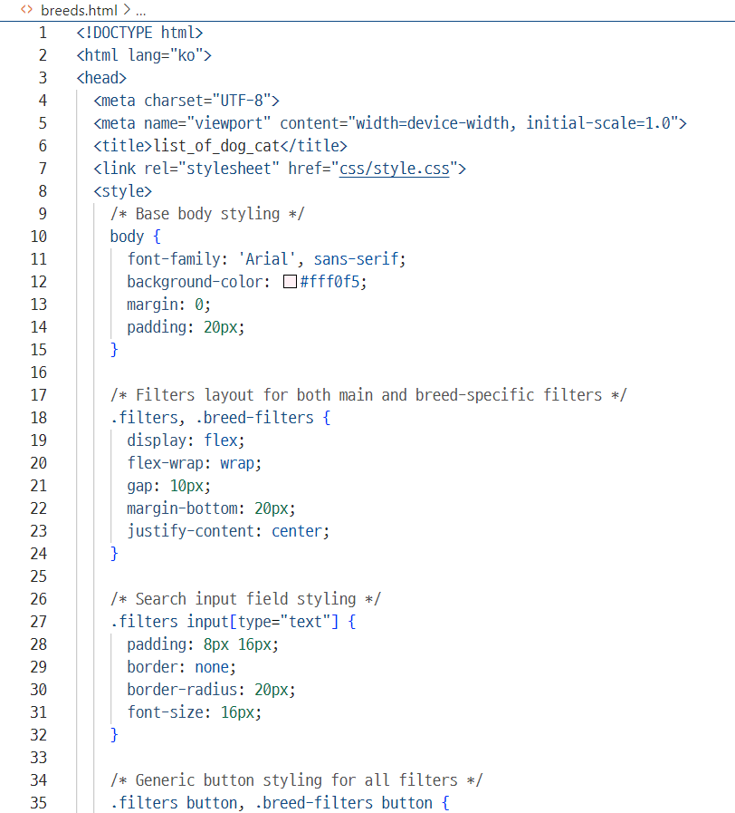
breeds.html– Code Snippet

Slide 15
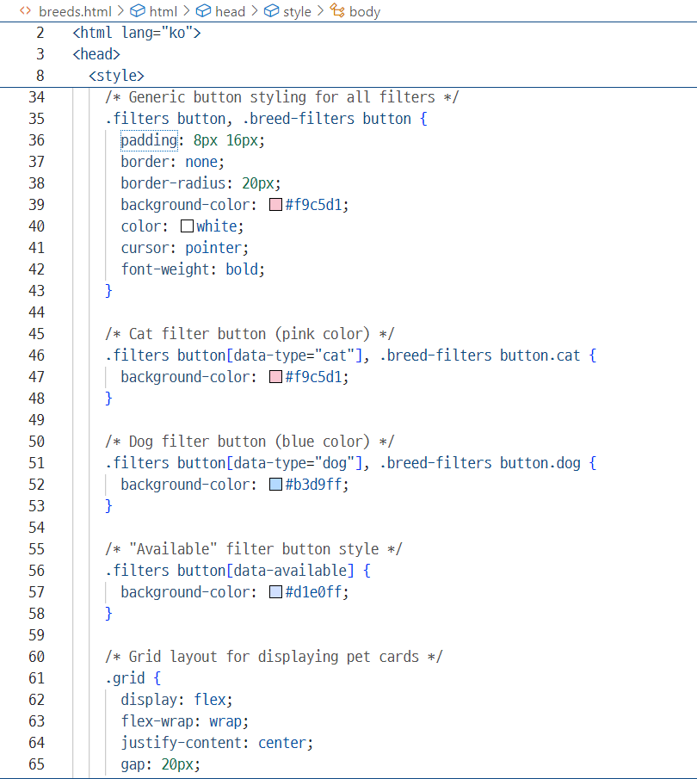
breeds.html– Code Snippet

Slide 16
Index.html
index.html is the first page users see.It guides them to start exploring adoptable petswith a simple, clean, and welcoming interface.
<head> includes:
style.css for styling, Google Fonts and faviconResponsive meta tag
<body> contains:
1.A <div class="container"> centered using Flexbox
Title and subtitle text welcoming users
2.Two main buttons:
"Adopt a Dog" → links to breed list
"Adopt a Cat" → links to breed list
Styling & Layout:
Uses Flexbox to center content vertically and horizontally
Buttons have hover effects for interactivity
Background uses a soft, themed color for a warm feel
.

Slide 17
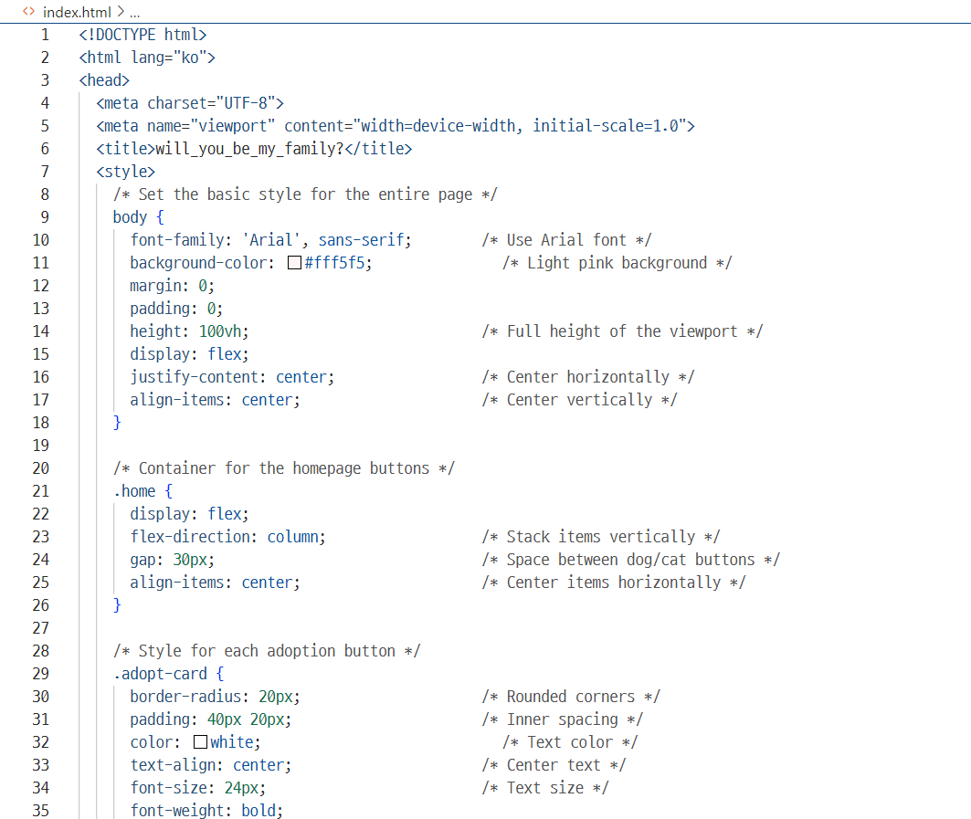
index.html– Code Snippet

Slide 18
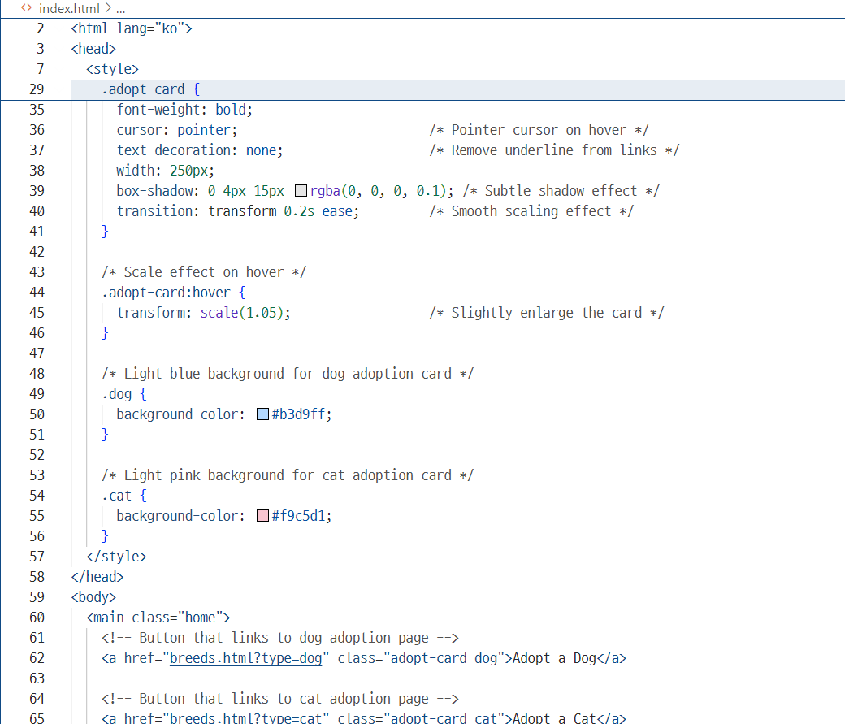
index.html– Code Snippet

Slide 19
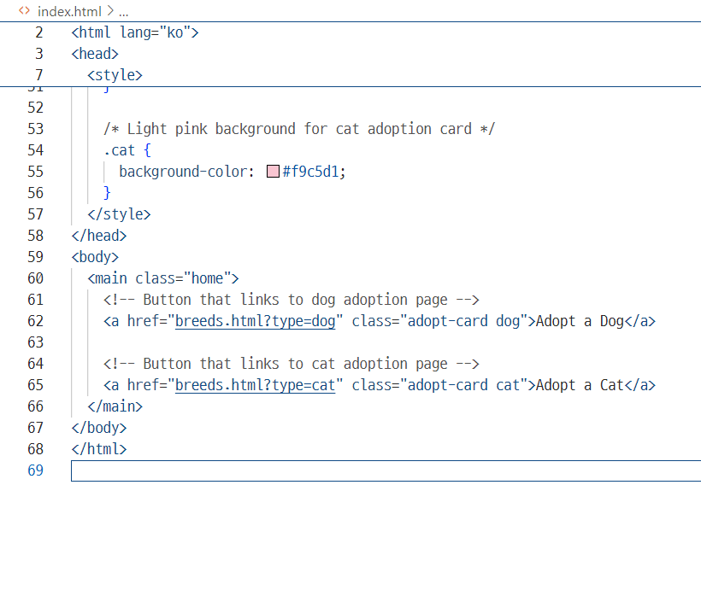
index.html– Code Snippet

Slide 20
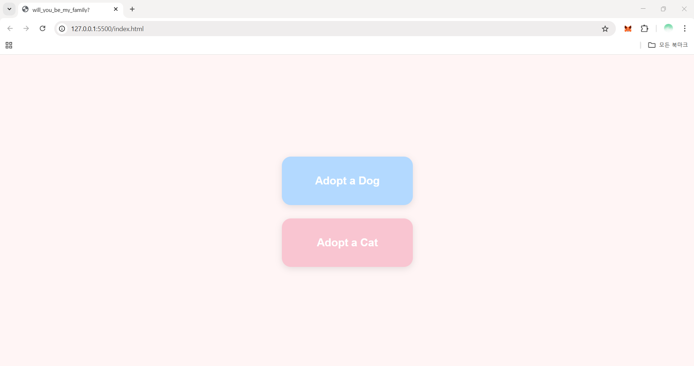
Design-first page of website

Slide 21
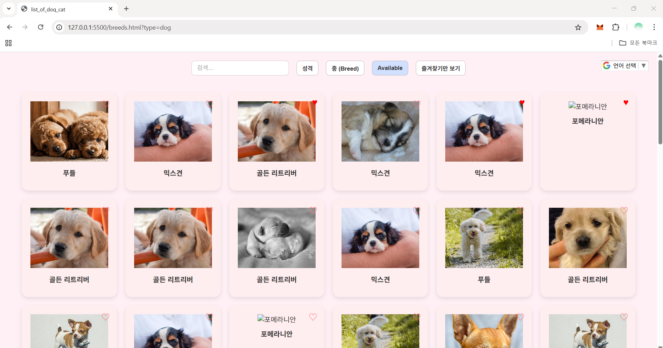
Website home

Slide 22
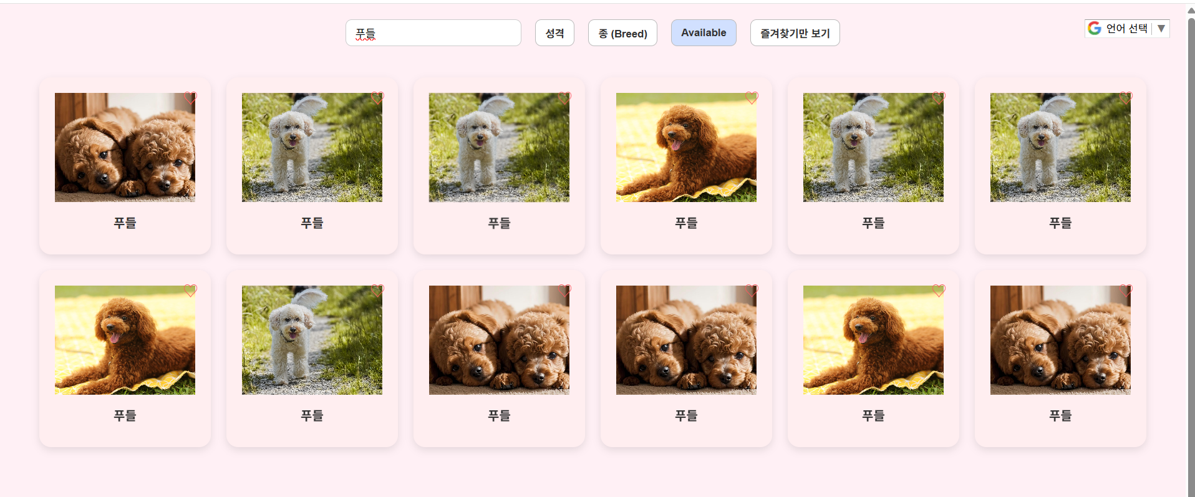
Search page

Slide 23
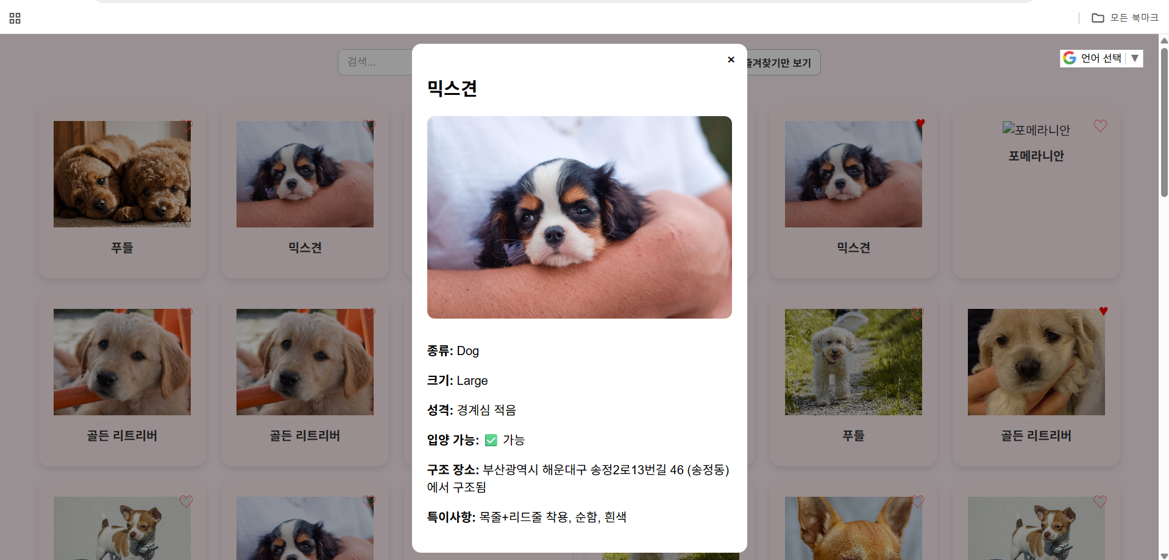
Detail page

Slide 24
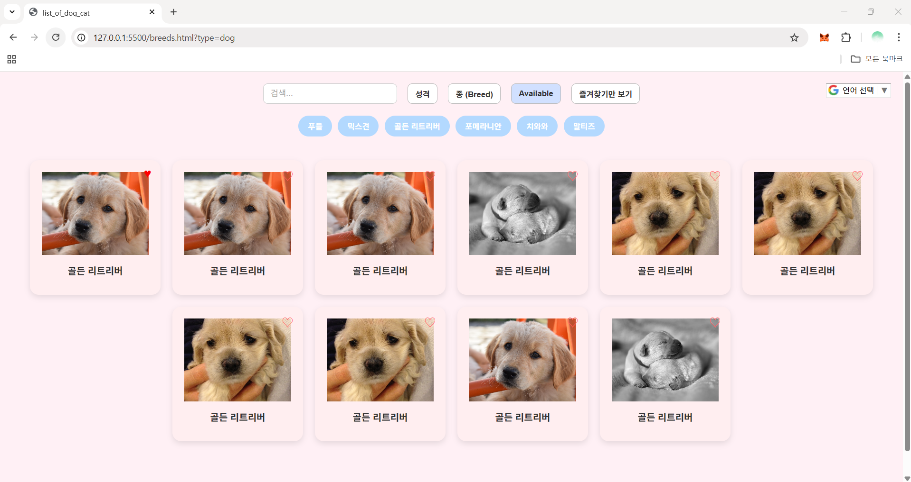
Breed filter

Slide 25
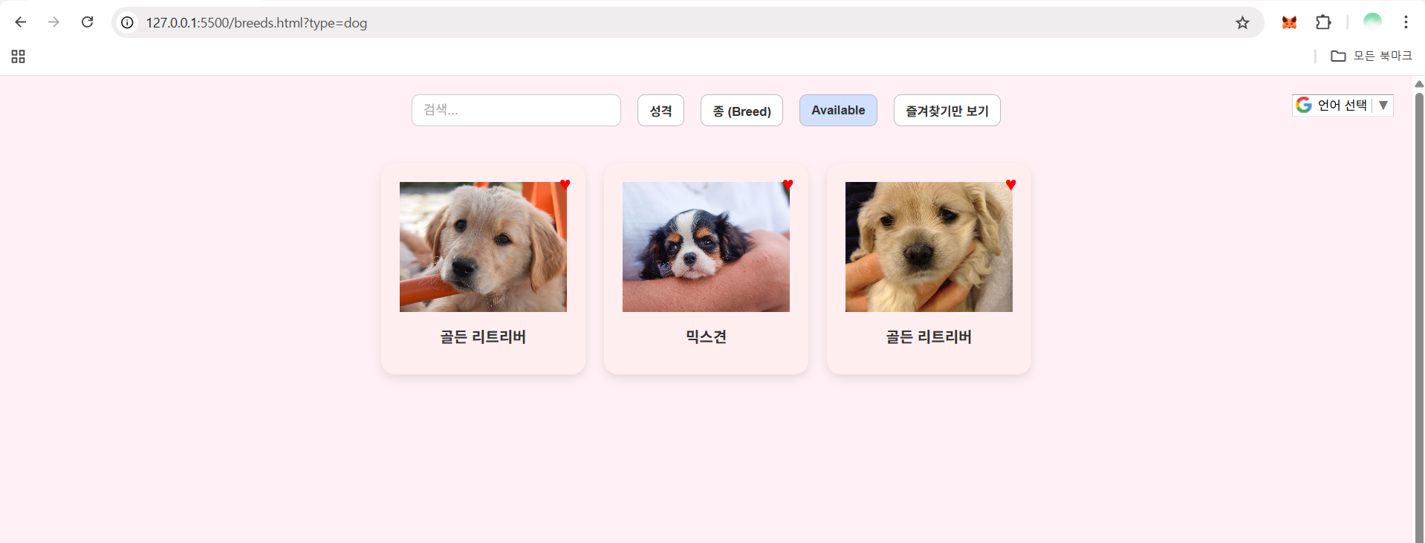
Like function

Slide 26
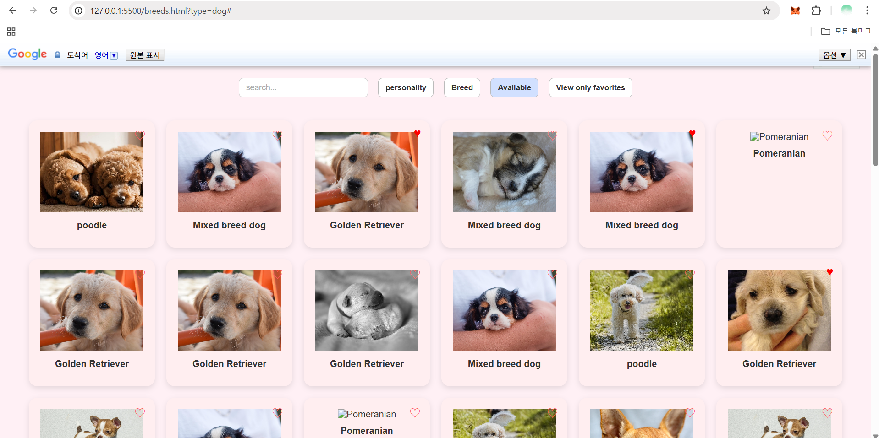
Translate function

Slide 27
Things to improve
The images are vertically too large, making it difficult to view details → Will resize them appropriately
.Will add images of a Pomeranian and a cat.
The heart icon for favorites will be resized to appear larger.
Will add Google Maps to show the shelter location of each animal.
Will include a new location filter button, allowing users to search by district or neighborhood.
Originally planned to use real animal photos, but replaced with free images due to access restrictions.
Will refine personality classification using two aspects:
Activity level: Active / Calm, Guardedness: High / Low

Slide 28
Things to improve
On the main page,will add the site title "Will you be my family?" in a speech bubble from an animal, and include the site’s purpose above or below the "Adopt a Dog / Cat" cards.
Will change the background color of the filter (search) page to gray,while keeping the card colors unchanged.
Will improve the design details of the buttons and the search bar for better visual quality.Fixed an issue where clicking a breed button keeps it active even after another button is selected →Will fix it using token-based logic or improved state management
.Currently, English keyword search doesn’t work properly →Will modify the logic to support English search (case-insensitive).

